Slide 1
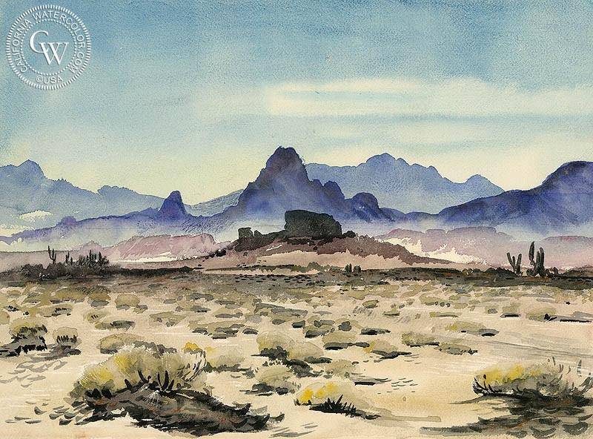

Exploring the effects of artificial deploys on dryland communities in California.
Ghazian Progress Report
Winter 2020

Slide 2
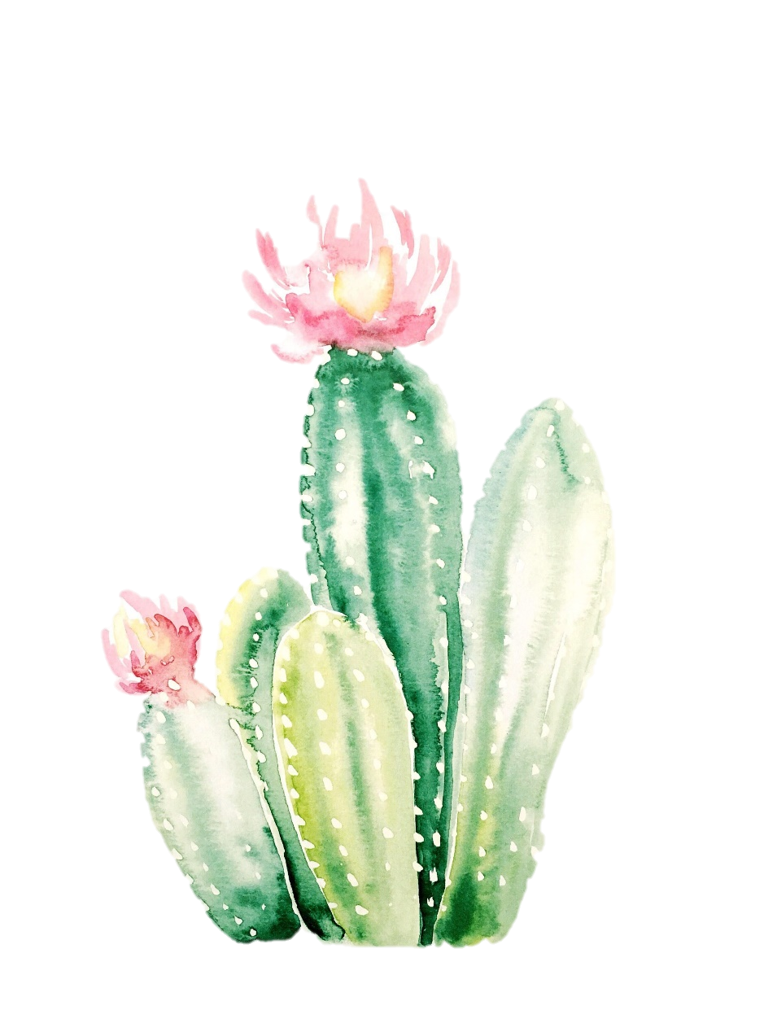
Overview
Chapter | Title | Estimated Timeline
1 | Effects of shelters on understory plant growth. | Winter-spring (blooming season) of 2022.
2 | Mega chapter: Animal-shelter/artificial deploy interactions. | Possibly spring-summer 2021 (COVID-19 dependent).
Bonus Idea 1 | International Shelter Protocol. | TBD
Bonus Idea 2 | Wildlife study in a different dryland system (Kenya or Israel). | TBD

Slide 3

Background
Desertification is growing issue in semi-arid and arid systems.
Drylands compromise ~40% if the global land surface (Verón et al. 2006)
Organisms in drylands are sensitive to small-scale fluctuations.
Active restoration strategies are key.

Slide 4
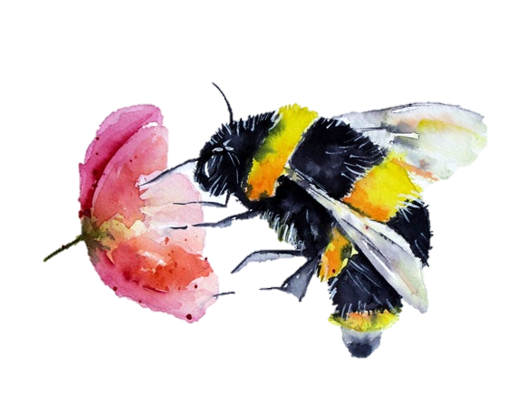
Background
Facilitation is an interaction where one or more species (beneficiary) benefit from a benefactor, whilst none are harmed (0, +).
Increase in stress – such as abiotic stress – increases facilitative interactions.
This is known as Stress Gradient Hypothesis (SGH) (Bertness and Callaway 1994).

Slide 5
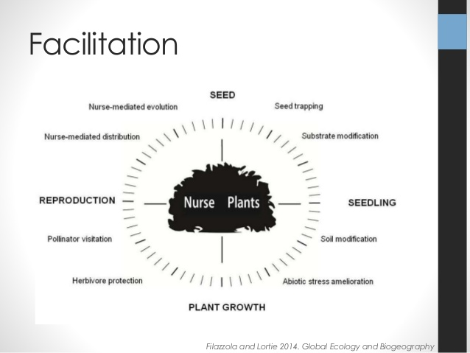
Background: Foundation Shrubs or Nurse Plants

Slide 6
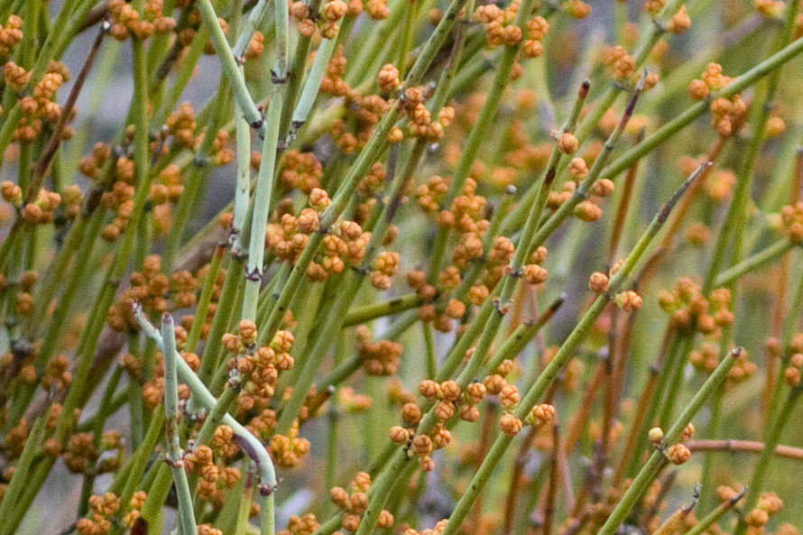
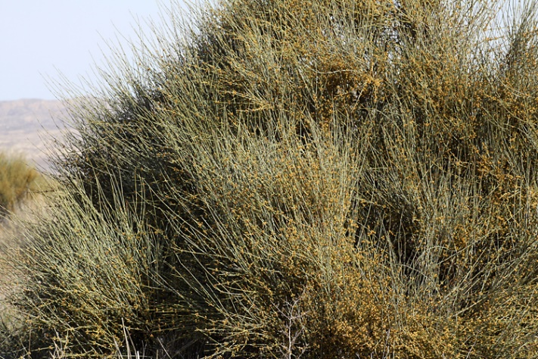
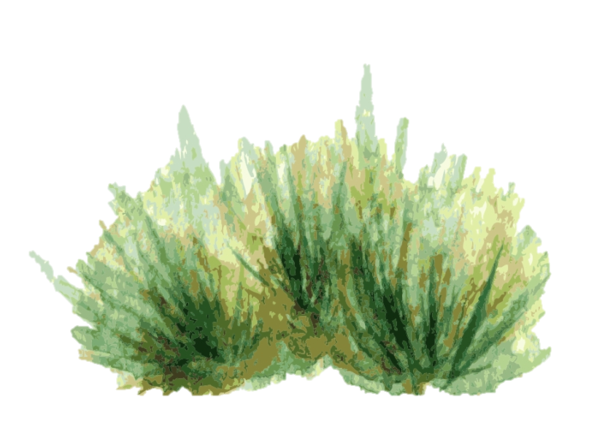
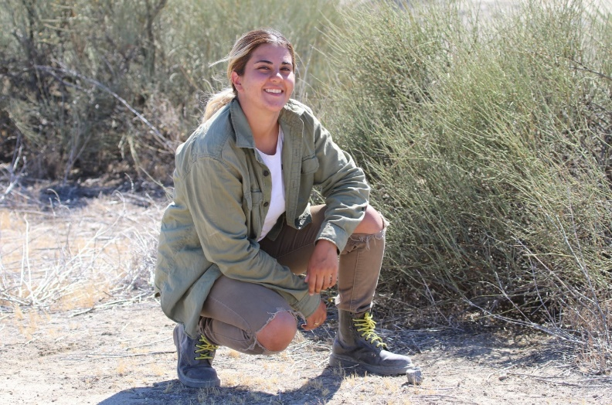
Background: Ephedra californica
Commonly known as Mormon Tea.

Slide 7
Big Concept
“Heterogeneity in micro-climate and habitat at fine scales is important for the maintenance of biodiversity”

Slide 8
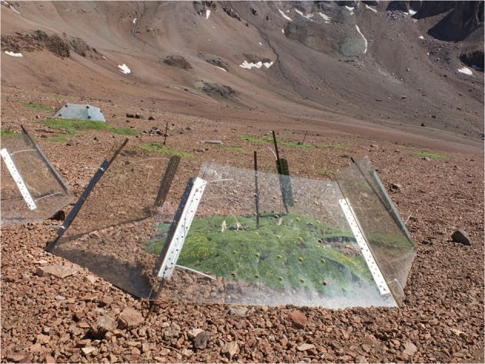
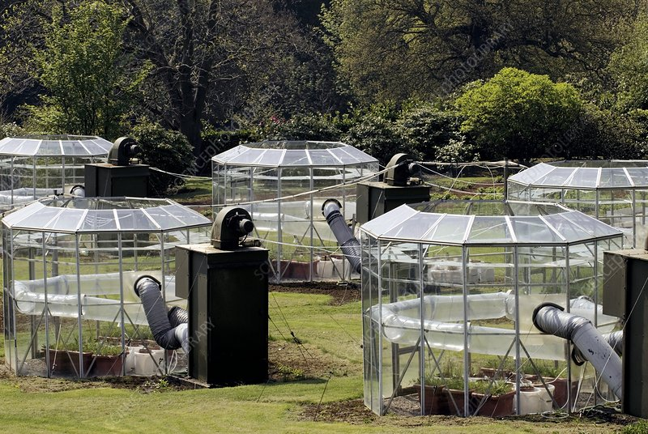
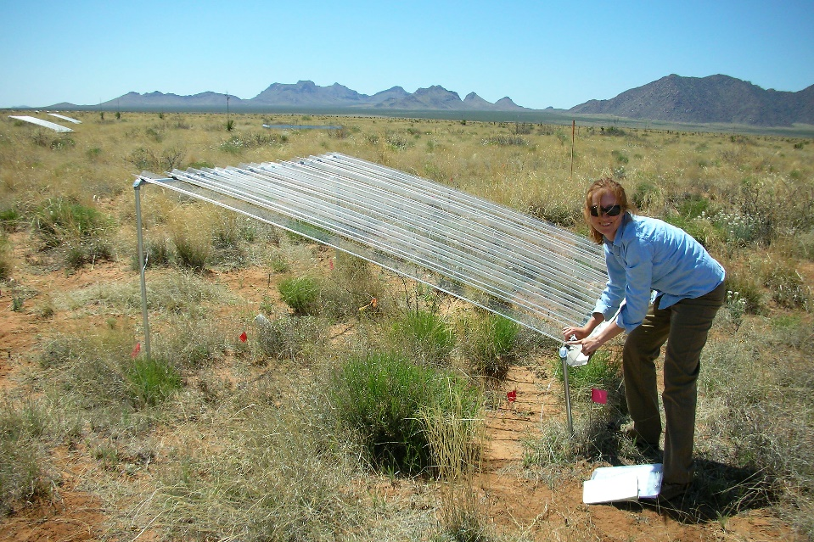
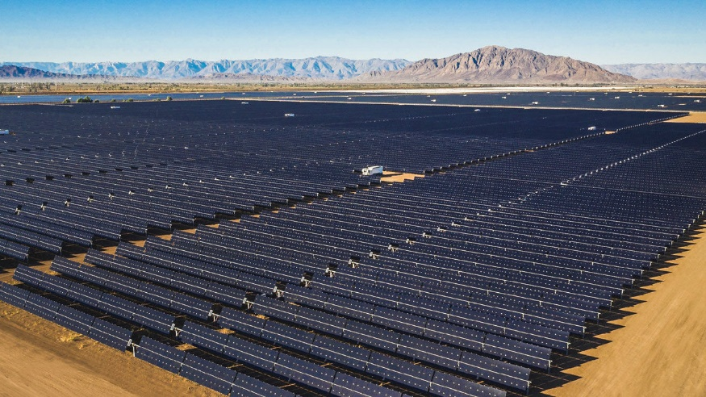
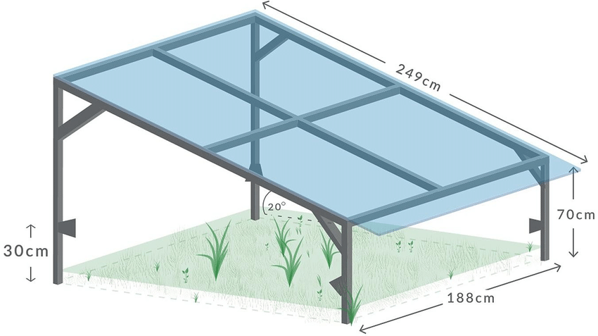
Google Images

Slide 9
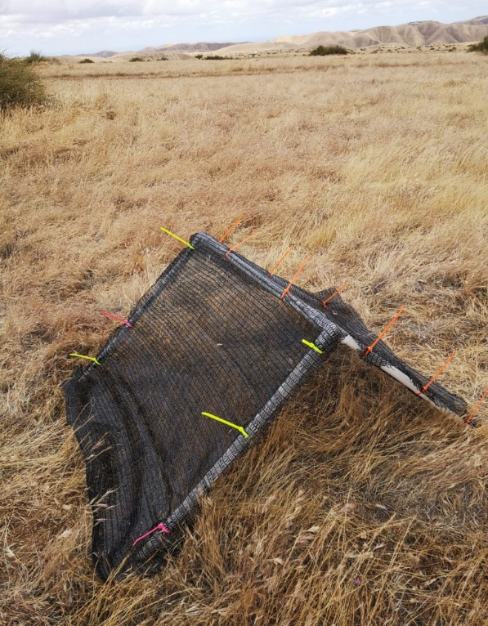
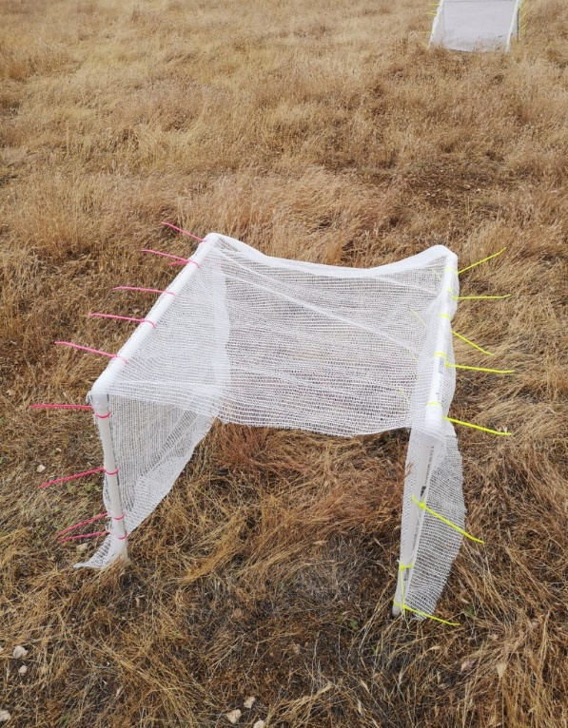
Previous Work
Ghazian et al. 2020
Notes:
Ghazian et al. 2020

Slide 10
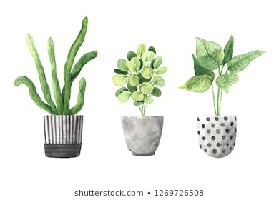
CH1: Effects of Shelter on Understory plant growth.
Purpose: To quantify the extent to which shelters facilitate the understory annual community in comparison to natural Ephedera califronica shrubs and the open gap.

Slide 11
Questions:
How do UV permeable artificial shelters modify microclimate parameters such as RH?
How does UV permeability affect understory annual growth?
Are all annuals facilitated to the same extend?
How this compare to annuals planted under natural shrubs and in the open?
Hypothesis:
Percent cover of annual plants does not differ between shrubs and artificial shelters, and both will be significantly higher than the open.
Water is an important co-variate that significantly increases plant growth compared to un-watered microsites.

Slide 12
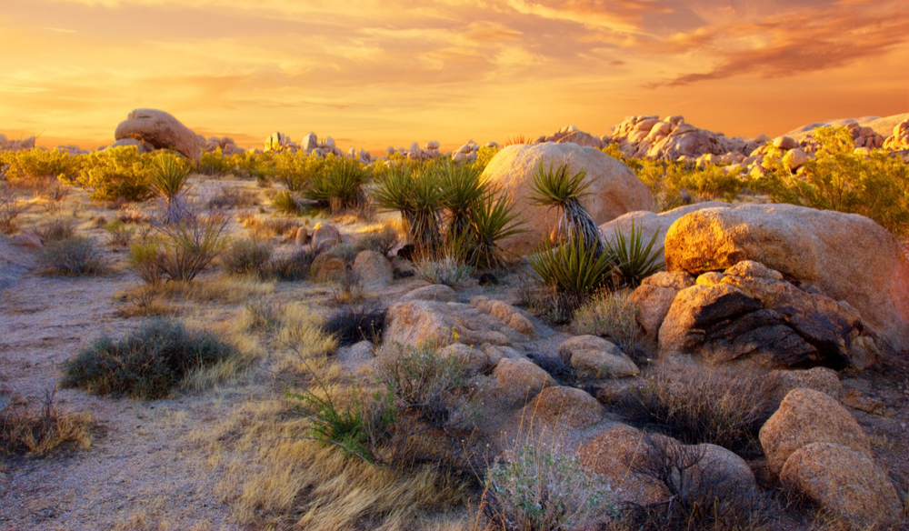
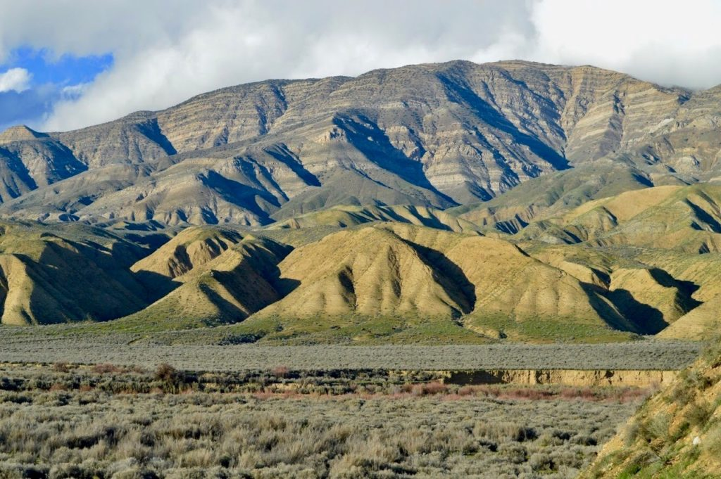
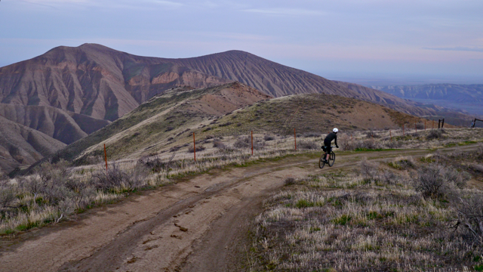
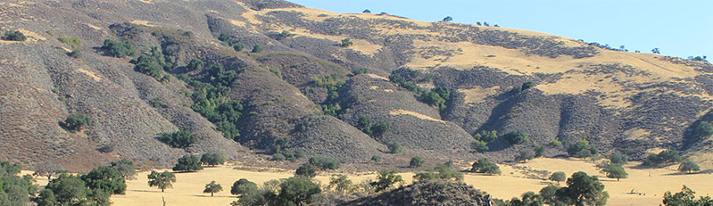
Methods- Sites
Mojave Desert
Carrizo Plain
Panoche Hills
Cuyama Valley

Slide 13
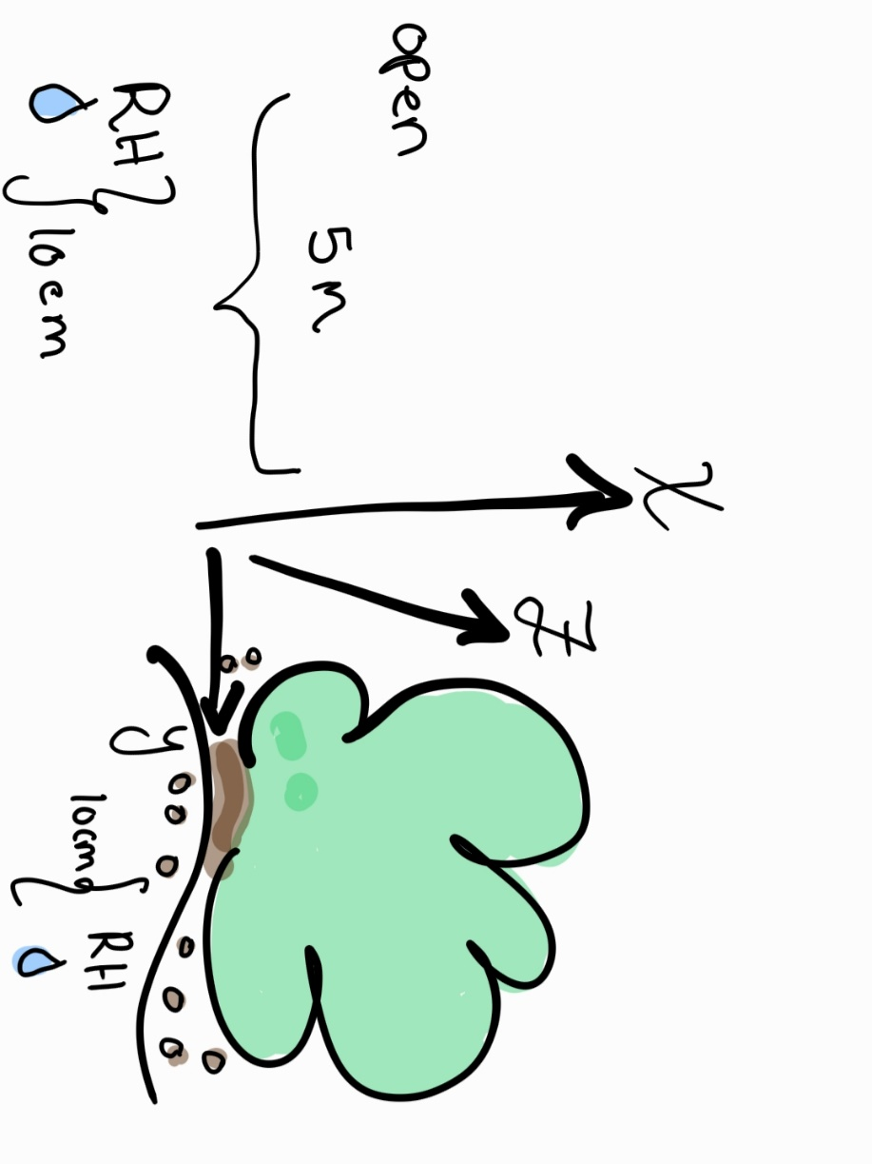
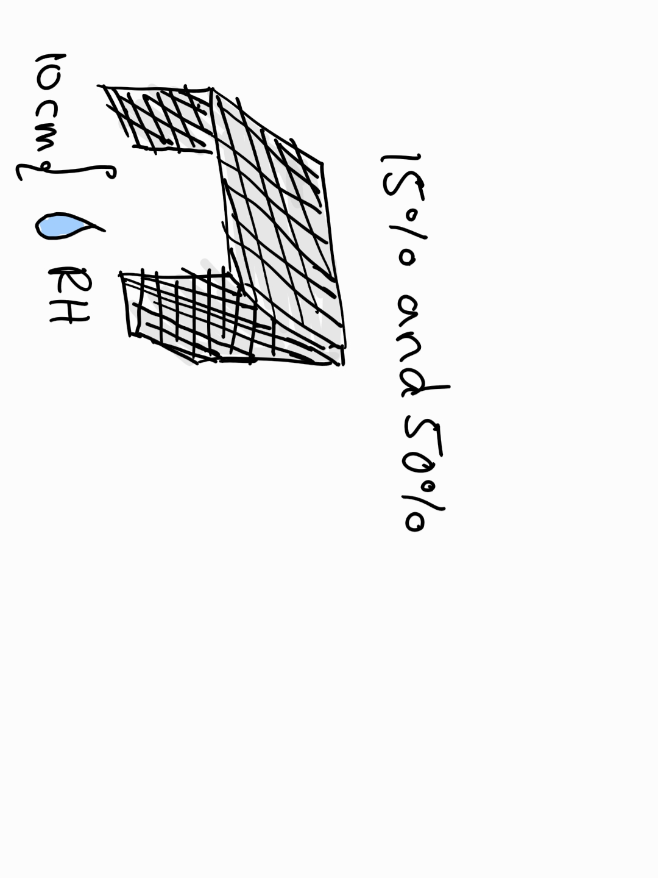
Design
1 shape x 2 permeabilities x 6 replicates
Water 3 of each regularly (6 total)
8 shrubs and 8 opens
Water 4 shrub/open microsite regularly

Slide 14
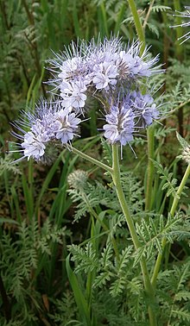
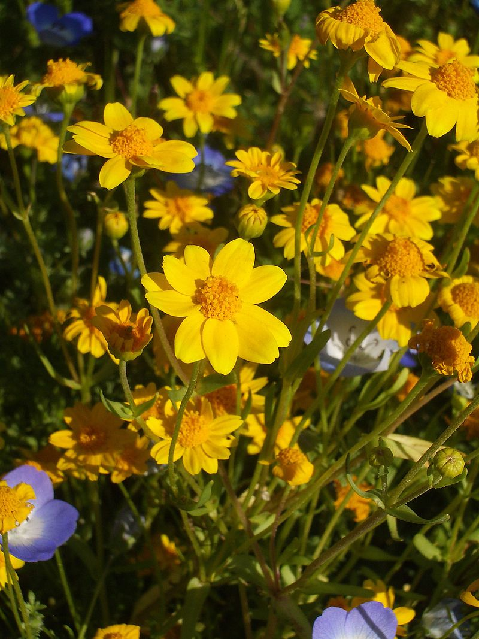
Possible Plants
?
Lasthenia californica
Phacelia tanacetifolia

Slide 15
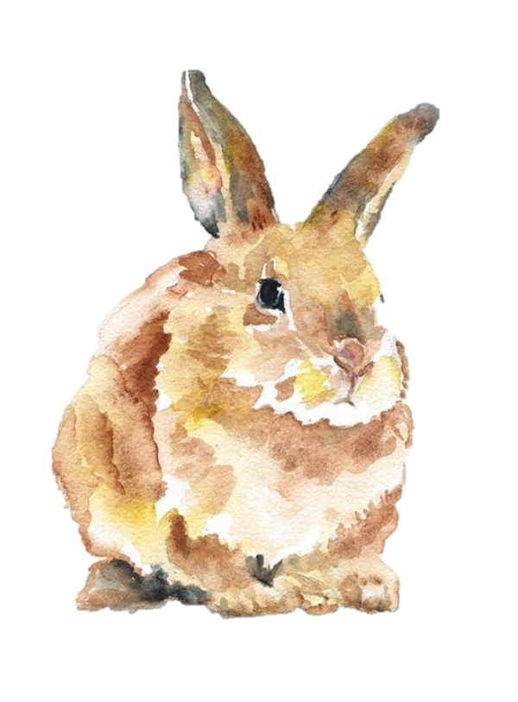
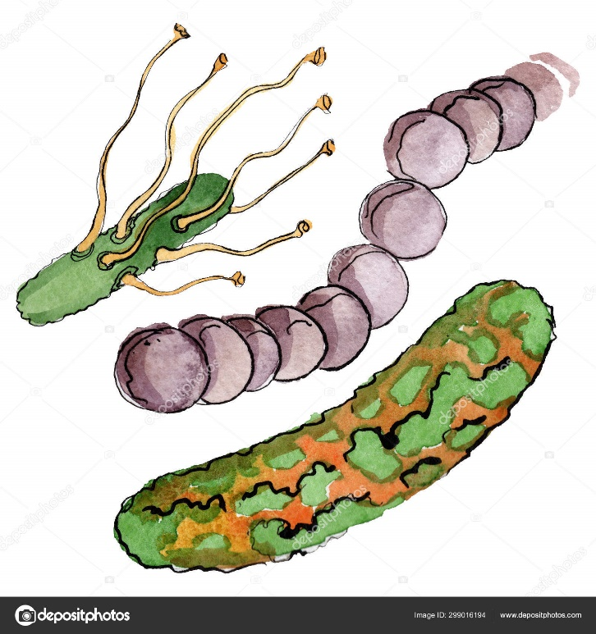
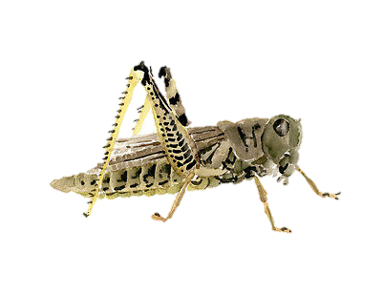
CH2: Animal-shelter interactions.
Purpose: To examine wildlife interactions with artificial shelters and to investigate how artificial shelters impact the soil microbial community.

Slide 16
Questions:
How do UV permeable shelters modify the soil microbial community richness and abundance?
How often do vertebrates interact with artificial shelters?
Which species interact with shelters the most?
What are they doing when interacting with shelters?
Do arthropods interacts with shelters?
If yes, which species do most often?
Does the richness and abundance of microbes differ between shelters, shrubs, and the open?
Is the frequency and direction of vertebrate and arthropod interaction with shelters different from shrubs and the open?
Hypothesis:
The magnitude and direction of association of vertebrates, arthropods, and soil microbes will be similar between natural shrubs and artificial shelters, and both will significantly differ from the open.

Slide 17
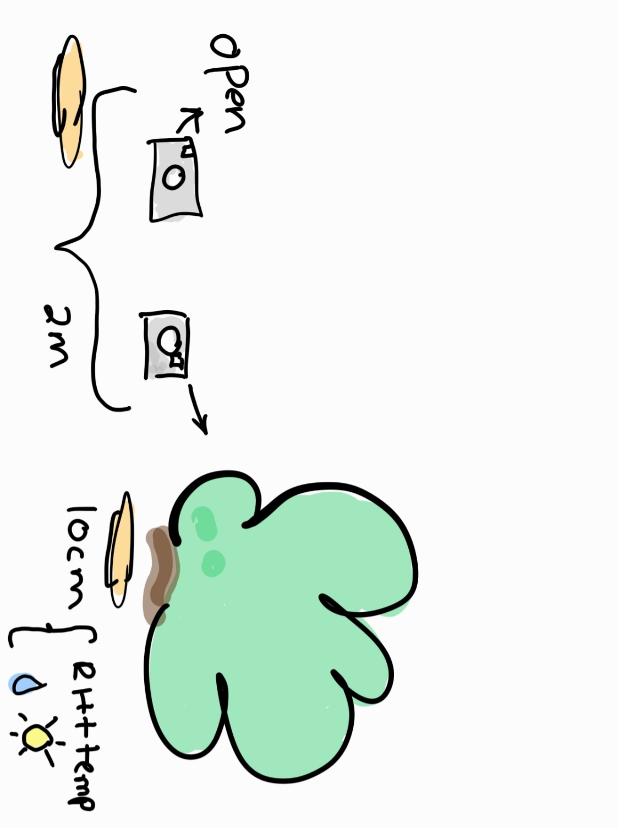
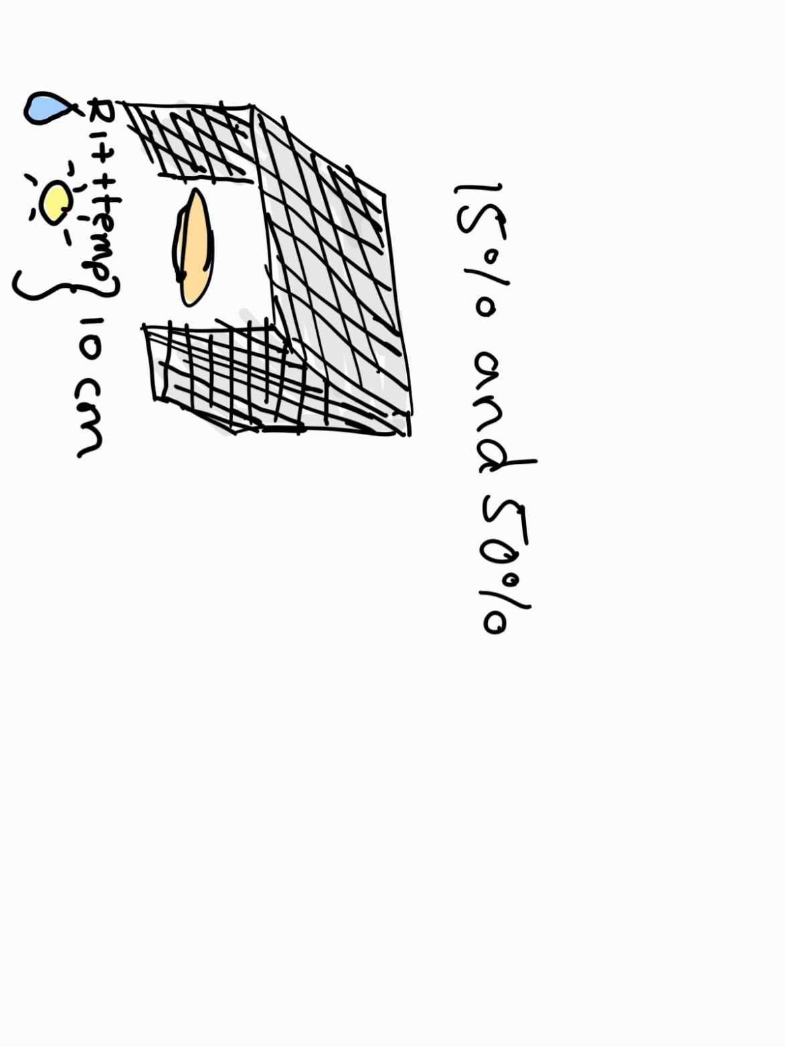
Design
1 shape x 2 permeabilities x 6 replicates
8 shrub/open pairs

Slide 18
Mega Ideas
Explore food-web dynamics through predator-prey interactions.
3 very different sites: no shrubs ever, damaged shrubs, and healthy shrubs.
Do exact same protocols in two different locations.
Test protocols under anther dryland deploy like solar farms.

Slide 19


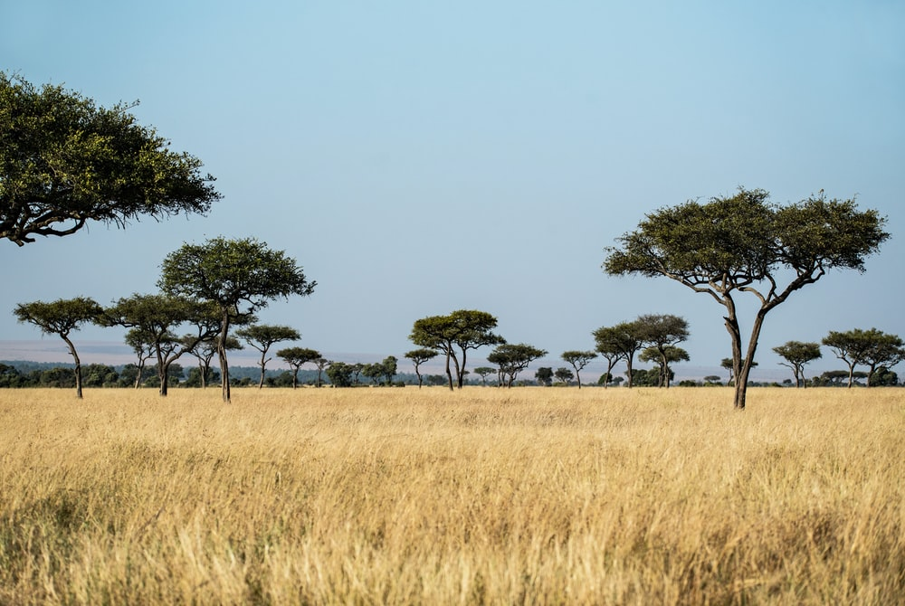
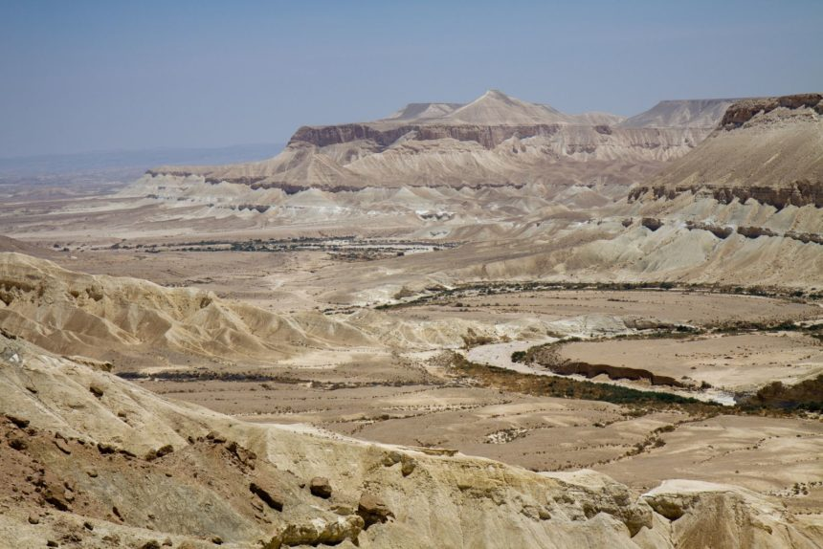
Bonus Chapter Ideas

Slide 20




Thank You!
Dr. Chris Lortie
Dr. Suzanne MacDonald
Dr. Laura McKinnon
Mario Zuliani
U.S. Bureau of Land Management (BLM)

